Slide 1


Azure Service Bus & NServiceBus
Setting up communication across boundaries
Yves Goeleven & Sean Feldman
Solution Architects & Azure MVPs
http://particular.net
Notes:
Setting up communication across network boundaries

Slide 2


When do you need Azure Service Bus ?
Secure & reliable communication between software components across network boundaries.
Inside cloud services
Between datacenters
Between branch offices
Hybrid solutions
IoT & Mobile devices
✓
✓
✗
NServiceBus & Azure Service Bus
Introduction to ServiceInsight for NServiceBus

Slide 3
What is NServiceBus for?
Framework to simplify the development of distributed business and workflow applications.
.NET native workflow & pub/sub
Simplicity, reliability, scalability and performance
Runs on premises, in the cloud, or either
Supports a wide range of messaging transports, deals with transport technology complexity
Endpoint
Endpoint
Transport
Azure Service Bus
RabbitMQ
SQL Server
MSMQ
ASQ
SQS
…
NServiceBus & Azure Service Bus
Introduction to ServiceInsight for NServiceBus

Slide 4
NServiceBus – simple overview
An Endpoint is a logical entity that communicates with other Endpoints via messaging.
Endpoint typically equates to a process.
Each Endpoint
Has an identifying name
Contains a collection of Message Handlers and Sagas
Can be deployed to a number of machines and environments (instances)
Endpoint
Endpoint
Transport
class PlaceOrder : ICommand
{
public Guid Id { get; set; }
public string Product { get; set; }
}
instance.Send(new PlaceOrder())
class Handler : IHandleMessages<PlaceOrder>
{
Task Handle(PlaceOrder message)
{
// your code here
}
}
NServiceBus & Azure Service Bus
Introduction to ServiceInsight for NServiceBus

Slide 5
Demo
https://docs.particular.net/samples/azure/azure-service-bus/

Slide 6
NServiceBus - endpoint internals
Transport => MessagePump + Dispatcher ( + additional features)
Forked pipeline of behaviors (handler returns)
Some behaviors might invoke transactional resources like Persisters
Startup infrastructure (TransportDefinition, Feature, Installer, ...)
Startup Infrastructure
Handler
MessagePump
Dispatcher
NServiceBus & Azure Service Bus
Introduction to ServiceInsight for NServiceBus

Slide 7
Connectivity

Slide 8
Creation
Installer called at startup
TopologyCreator inquires Topology for what needs to be created
For each entity in the topology constructs creator object
Which in turn uses namespace manager to create entities
deals with all possible exceptions
Topology
What needs to be created?
Queue, Topic & Subscription Creators
NamespaceManager
Installer
TopologyCreator
SubscriptionManager
NServiceBus & Azure Service Bus
Introduction to ServiceInsight for NServiceBus

Slide 9
Connectivity Management
MessagePump & Dispatched inquire Topology to know what to receive from/send to
Pools of receivers, senders & factories (default poolsize = #cores)
Active lifecycle management (connection reestablished on drop)
Circuit breaker pattern
LifecycleManager
Topology
LifecycleManager
Pool of receivers
Circuit breaker
Pool of senders
MessagePump
Dispatcher
Context
LifecycleManager
SBMP over TCP
SBMP over TCP
Pool of factories
NServiceBus & Azure Service Bus
Introduction to ServiceInsight for NServiceBus

Slide 10
What is a topology?
Represents the layout of service bus entities that allow endpoints to communicate.
Explicit concept in transport so that it can be swapped.
ASB’s forwarding feature provides near endless possibilities.
Topology
Endpoint B
Endpoint A
Endpoint C
Forwarding
NServiceBus & Azure Service Bus
Introduction to ServiceInsight for NServiceBus

Slide 11
Let’s have a look at some topologies

Slide 12
Things to consider for a topology
Entity usage
Commands vs Events
Embed message types (f.e. filters, entity names)
Does each namespace type support the entities used
Native capabilities
Ownership
Endpoints may not be aware of the full topology
Awareness creates coupling, do you want that?
Some entities may not belong to any endpoint
Performance impact
(Backwards) compatability
Multiple namespaces, Partitioning, HA
No forwarding between namespaces
NServiceBus & Azure Service Bus
Introduction to ServiceInsight for NServiceBus

Slide 13
Basic topology
Each endpoint has its own input queue
Sends direct to input queue, does not leverage pub/sub capabilities of ASB, instead uses storage driven publishing from NSB
Endpoint B
Sphere of ownership
Endpoint A
Endpoint C
NServiceBus & Azure Service Bus
Introduction to ServiceInsight for NServiceBus

Slide 14
Basic topology: pros and cons
Pros | Cons
Simple mode | No native pub/sub
Can leverage any messaging namespace type (Basic, standard, premium) | Publisher coupled to subscriber (in both directions)
Easy to port from MSMQ | External dependency on storage
Integrates with auto-scale | No native auditing on commands/events
NServiceBus & Azure Service Bus
Introduction to ServiceInsight for NServiceBus

Slide 15
Endpoint oriented topology
Each endpoint has its own input queue & topic
Sends direct to input queue, publish via topic
Endpoint B
EndpointB.TypeA
Endpoint A
EndpointB.TypeB
EndpointA.Events
EndpointC.TypeA
Endpoint C
NServiceBus & Azure Service Bus
Introduction to ServiceInsight for NServiceBus

Slide 16
Endpoint oriented topology: pros and cons
Pros | Cons
Publisher decoupled from subscribers | Subscribers coupled to Publishers
No dependency on storage | Hard to use polymorphic events
 | Cannot handle changes in event hierarchy
 | Possible event overflow
Integrates with auto-scale | Auto-scale for input queue only
 | Can not leverage basic namespace
Native auditing on events | Native auditing on events very hard
 | No native auditing on commands
NServiceBus & Azure Service Bus
Introduction to ServiceInsight for NServiceBus

Slide 17
Forwarding topology
Each endpoint has its own input queue, shared topics for publishing
Sends direct to input queue, publish via topic
Endpoint B
EndpointB
Type A Type B
Endpoint A
Bundle-1
EndpointC
Type A
Endpoint C
NServiceBus & Azure Service Bus
Introduction to ServiceInsight for NServiceBus

Slide 18
Forwarding topology: pros and cons
Pros | Cons
No dependency on storage | Can not leverage basic namespace
No coupling between publisher & subscriber | No native auditing on commands
Supports polymorphism
Change in message hierarchy is transparent
Integrates with auto-scale
Protected against overflow
Native auditing on events
NServiceBus & Azure Service Bus
Introduction to ServiceInsight for NServiceBus

Slide 19
“Topic all the things” topology
Each endpoint has its own input topic, shared topics for publishing
Sends direct to input topic, publish via topic
Endpoint B
EndpointB
Type A Type B
Endpoint A
Bundle-1
EndpointC
Type A
Endpoint C
NServiceBus & Azure Service Bus
Introduction to ServiceInsight for NServiceBus

Slide 20
“Topic all the things” topology: pros and cons
Pros | Cons
No dependency on storage | Can not leverage basic namespace
No coupling between publisher & subscriber | Does not integrate with auto-scale
Supports polymorphism
Change in message hierarchy is transparent
Protected against overflow
Native auditing on commands & events
NServiceBus & Azure Service Bus
Introduction to ServiceInsight for NServiceBus

Slide 21
Reliable Message Exchange: Receiving

Slide 22
Receiving
Talk about defaults for connectivity mode, transport type, concurrency, number of clients, …
Talk about how nsb dispatches received message (based on type in header)
Talk about how nsb’s transactionmode translates to receivemode (and not to transactionscope)
Overall: how we receive messages and how we decide on what handles are getting invoked.
Cover things like transport encoding (headers, stream/byte[], deserialization, handler dispatching/polymorphism, etc.)
Azure Service Bus
Introduction to ServiceInsight for NServiceBus

Slide 23
NSB Transaction Modes
1. Unreliable – TXs disabled
2. Receive Only – transport TXs
3. Sends atomic with Receive
4. Transaction Scope – Distributed TXs
NServiceBus & Azure Service Bus
Introduction to ServiceInsight for NServiceBus

Slide 24
Transaction Mode: Unreliable
Receive And Delete
ReceiveAndDelete receive mode
Not recommended as when failures occur, messages will be permanently lost.
Use case: telemetry
✗ Delete
Endpoint
NServiceBus & Azure Service Bus
Introduction to ServiceInsight for NServiceBus

Slide 25

Transaction Mode: Receive Only
PeekLock receive mode
Partial results
Updates to data stores
Message sends
Higher performance
HA – multiple namespaces
Temporal Lock
Endpoint
DLQ
✗ Delete
NServiceBus & Azure Service Bus
Introduction to ServiceInsight for NServiceBus

Slide 26
Transaction Mode: Sends atomic with Receive
PeekLock receive mode + transaction + send via
No ghost messages
BUT, data is not included
in transport transaction (data should have its own transaction)
Endpoint
Temporal Lock
MessageReceiver
DLQ
✗ Delete
Message Sender
NServiceBus & Azure Service Bus
Introduction to ServiceInsight for NServiceBus

Slide 27
Transaction Mode: Sends atomic with Receive
Send via requires transaction scope
That scope does not allow other transactional resources inside it
Requires strategic suppress scopes in the pipeline to work
Suppress scope
wraps Handler scope
Connections enlists in Handler scope
Via scope
wraps pipeline invocation
Handler
Enlists in Via scope
MessagePump
Dispatcher
Connections must be wrapped in suppress scope
NServiceBus & Azure Service Bus
Introduction to ServiceInsight for NServiceBus

Slide 28
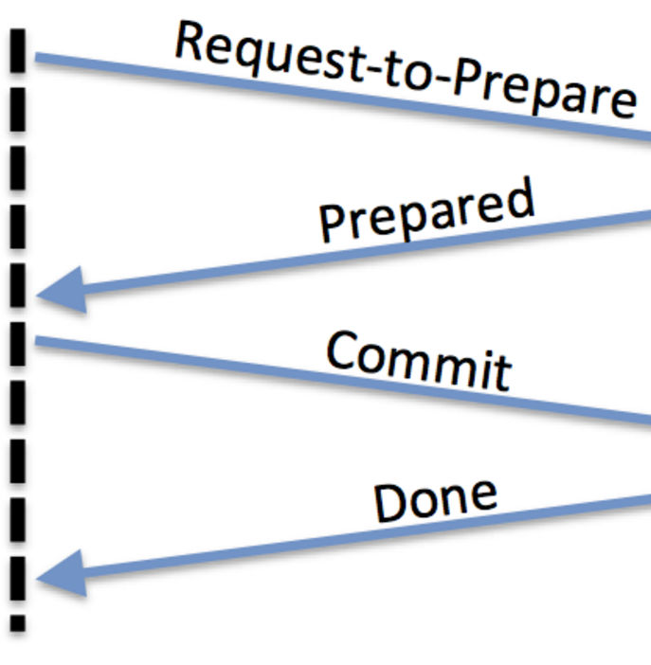
Transaction Mode: Transaction Scope
DTC is not supported by ASB
NServiceBus & Azure Service Bus
Introduction to ServiceInsight for NServiceBus

Slide 29
Business errors
- Successfully processed messages go to Audit queue
- Recoverability for failed messages
- Immediate retries
- Delayed retries
Messages failed all retries go to Error queue
Total Number of Attempts
(ImmediateRetries:NumberOfRetries + 1) x (DelayedRetries:NumberOfRetries + 1)
NServiceBus & Azure Service Bus
Introduction to ServiceInsight for NServiceBus

Slide 30
Poisonous & dead-lettered messages
Poisonous messages are
dead lettered w/o retries
Messages with number of immediate retries bigger than entity`s delivery will dead letter.
Unsupported Transport encoding (i.e. not stream or byte[])
Example:
Immediate retries set to X
Entity`s DeliveryCount set to X-1
NServiceBus & Azure Service Bus
Introduction to ServiceInsight for NServiceBus

Slide 31
Reliable Message Exchange: Sending

Slide 32
Dispatch Mode
Default dispatch mode: batched
Namespace
Endpoint A
Batch
Endpoint B
Optional (explicit): immediate
Namespace
Endpoint A
1
Endpoint B
2
Batch
NServiceBus & Azure Service Bus
Introduction to ServiceInsight for NServiceBus

Slide 33
Dispatching to multiple namespaces
Each namespace is sent separately
Namespace 1
Batch
Endpoint B
Endpoint A
Batch
Namespace 2
Batch
Endpoint C
NServiceBus & Azure Service Bus
Introduction to ServiceInsight for NServiceBus

Slide 34
Batch Size
Batch size is estimated using padding percentage. Default padding: 5%.
Calculated message size
= Raw body size
+ Custom headers size (keys + values)
+ Standard properties estimated size
+ padding %
…
Body Size
Body Size
Body Size
Body Size
Custom Headers
(keys + values)
…
Custom Headers
(keys + values)
Custom Headers
(keys + values)
…
Custom Headers
(keys + values)
Standard Properties
(estimated)
Standard Properties
(estimated)
Standard Properties
(estimated)
Standard Properties
(estimated)
Padding %
Padding %
Padding %
Padding %
Up to MAX_SIZE or 100 messages
NServiceBus & Azure Service Bus
Introduction to ServiceInsight for NServiceBus

Slide 35
Performance Tuning
Defaults & what needs to be considered if really high perf is required
Awaiting for combined Tasks vs individual tasks
Number of Factories and clients, concurrency, prefetch
NServiceBus & Azure Service Bus
Introduction to ServiceInsight for NServiceBus

Slide 36
Demo
https://docs.particular.net/samples/azure/performance-tuning-asb/

Slide 37
Thank you

Slide 38
Q&A

Slide 39
Abstract.
Need to set up secure communication between your software components across network boundaries?
Yves Goeleven and Sean Feldman will show you what it takes to use the Azure Service Bus for this purpose.
Learn how to:
Set up and maintain the connection with the broker.
Ensure reliable message exchange.
Optimize performance.
Azure Service Bus
Introduction to ServiceInsight for NServiceBus

